Slide 1
Denial-of-Service
David Andersen
CMU CS 15-744

Slide 2
Today’s Lecture
What is Denial of Service?
Attacks and Defenses
  Packet-flooding attacks
    Attack: SYN Floods
    Defenses: Ingress Filtering, SYN Cookies, Client puzzles
  Low-rate attacks
    Detection: Single-packet IP Traceback
Network-level defenses: sinkholes and blackholes
Inferring Denial of Service Activity
Distributed Denial of Service
Worms
Other resource exhaustion: spam

Slide 3
Denial of Service: What is it?
Attacker
Victim
Crash victim (exploit software flaws)
Attempt to exhaust victim's resources
  Network: Bandwidth
  Host
    Kernel: TCP connection state tables, etc.
    Application: CPU, memory, etc.
  Often high-rate attacks, but not always
graphics credit: Feamster

Slide 4
TCP: 3-Way Handshake
C
S
SYN_{C}
Listening
Create TCB
SYN_{S}, ACK_{C}
Wait
ACK_{S}
Connected
slide credit: Feamster
Notes:
25

Slide 5
Example: TCP SYN Floods
Each arriving SYN stores state at the server
  TCP Control Block (TCB)
  ~ 280 bytes
    FlowID, timer info, Sequence number, flow control status, out-of-band data, MSS, other options
Attack:
  Send TCP SYN packets with bogus src addr
  Half-open TCB entries exist until timeout
  Kernel limits on # of TCBs
Resources exhausted ⇒ requests rejected
Notes:
25

Slide 6
Preventing SYN floods
Principle 1: Minimize state before “auth”
  (3 way handshake == auth)
  Compressed TCP state: Very tiny state representation for half-open conns
    Don't create the full TCB
  A few bytes per connection == can store 100,000s of half-open connections

Slide 7
SYN Cookies (generalizes!)
Idea: Keep no state until auth.
  In response to SYN, send back self-validating token to source that source must attach to ACK
  SYN -> SYN/ACK+token -> ACK+token
    Validates that the receiver's IP is valid
  How to do in SYN? sequence #s!
    top 5 bits: time counter
    next 3: Encode the MSS
    bottom 24: F(client IP, port, server IP, port, t)
  Downside to this encoding: Loses options.

Slide 8
Bandwidth Floods
1990s: Brute force from a few machines
  Pretty easy to stop: Filter the sources
  Until they spoof their src addr!
Late 90s, early 00s: Traffic Amplifiers
  Spoofed source addrs (next)
Modern era: Botnets
  Use a worm to compromise 1000s+ of machines
  Often don't need to bother with spoofing

Slide 9
Reflector Attacks
Spoof source address
Send query to service
Response goes to victim
  If response >> query, “amplifies” attack
  Hides real attack source from victim
Amplifiers:
  DNS responses (50 byte query -> 400 byte resp)
  ICMP to broadcast addr (1 pkt -> 50 pkts) (“smurf”)

Slide 10
!Spoofing 1: Ingress/Egress Filtering
Drop all packets with source address other than 204.69.207.0/24
Internet
204.69.207.0/24
RFC 2827: Routers install filters to drop packets from networks that are not downstream
Feasible at edges; harder at “core”
Deployment incentive mismatch
Slide derived from Feamster

Slide 11
!Spoofing 2: uRPF Checks
Accept packet from interface only if forwarding table entry for source IP address matches ingress interface
Strict Mode
uRPF Enabled
10.0.18.3 from wrong interface
“A” Routing Table
Destination Next Hop
10.0.1.0/24 Int. 1
10.0.18.0/24 Int. 2
Unicast Reverse Path Forwarding
  Cisco: “ip verify unicast reverse-path”
Requires symmetric routing
Slide Credit: Feamster

Slide 12
Filters & Pushback
Assumption: Can identify anomalous traffic
(Coming in 2nd half of lecture)
Add “filters” that drop this traffic
  Access control lists in routers
  e.g. deny ip from dave.cmu.edu to victim.com tcp port 80
Pushback: Push filters further into network towards the source
  Need to know where to push the filters (traceback)
  Need authentication of filters...
  Tough problems. Filters usually deployed near victim.

Slide 13
Capabilities
Filters: prevent the bad stuff
Capabilities: must have permission to talk
Sender must first ask dst for permission
  If OK, dst gives capabilitiy to src
  capability proves to routers that traffic is OK
Good feature: stateless at routers

Slide 14
TVA
Routers put pre-capability in src->dst request
  Timestamp | Hash(src, dst, time, router secret)
  secret changes slowly
  dst sees these pre-capabilities and can echo them back to src if it wants to.
  Routers can verify pre-capability w/out state
Limited time & b/w:
  Timestamp | H(pre-caps, N bytes, Time T)
  dst gives src more N,T as appropriate

Slide 15
More TVA
Cute trick in paper for monitoring “heavy” flows
Similar trick for caching capabilities (space overhead in pkts vs. state in routers)

Slide 16
Discussion
“Denial-Of-Capability” - first pkt must get through
  But once one pkt makes it, flow is good.
  Vast improvement over today...
b/w exhaustion: cooperating attackers give each other many tokens
  Need fair queueing or similar
Route changes? Need new capability
How does dst know if sender is evil or not?

Slide 17
Detecting Attacks
Intrusion Detection Systems at host or net
  Assumes attack traffic is identifiable
  Hard with botnets that request legit web pages
    Captchas? Computational puzzles?
  Reasonable with many attacks

Slide 18
Traceback with Packet Markings
With probability p, each router marks packet hdr:
  Router IP
  Distance d from the source (increments @ each rtr)
Re-assemble the list of routers w/enough pkts
  Have to resist spoofing attacks at src
    But can trace back to where attacker controls
Improvement: edge sampling (src/dst IP of link)
Needs new IP header, or cute encoding tricks
  Increases # of packets that must be heard...
  Everyone abuses these fields. :)

Slide 19
Single packet traceback
Marking can ID bandwidth floods
But what about single-pkt DDoS or exploits?
Strawman 1: Log all packets!
  500Gbit/sec through a big core router
  4 TB for one minute of logging (!)
  Just headers? Maybe 100GB/minute. (!)
    Okay start, but ...
    A fast hard drive can write 4.2GB/minute...

Slide 20
Log Packet Digests
Goal: Receiver has copy of the packet
Ask router: “Have you seen this packet?”
  Mask out changing parts of pkt (TTL, TOS, checksum, opts)
  Include first 8 bytes of payload (TCP/UDP headers)
Hash these bytes -> 32 bits
Is this enough?
  BFRouter: 1B packets/sec = 4GBytes/sec
  That's a lot of pretty fast memory, but nearly there

Slide 21
Hash input: Invariant Content
Ver
HLen
TOS
Total Length
Identification
D
F
M
F
Fragment Offset
TTL
Protocol
Checksum
28
bytes
Source Address
Destination Address
Options
First 8 bytes of Payload
Remainder of Payload

Slide 22
Bloom Filters
Useful algorithmic trick: More space efficiency at cost of some false positives
Compute k independent hashes of the packet
  h1, h2, ..., hk each n bits long
Create an array of size 2^n bits
Set bits corresponding to h1, h2, ..., hk
  Can control FP rate by choosing n, k for the expected # elements in array
  e.g., 8 bits/entry: FP rate 2%

Slide 23
Traceback w/Bloom Filters
Down to 8 bits/packet: 1GB/sec (reasonable)
What about false positives?
  May get false neighbors saying “I saw it!”
  If false neighbors' neighbors don't, query dies
  So FP rate must be low enough to prevent query explosion
To query: Recursively query neighbors of router that says it saw packet

Slide 24
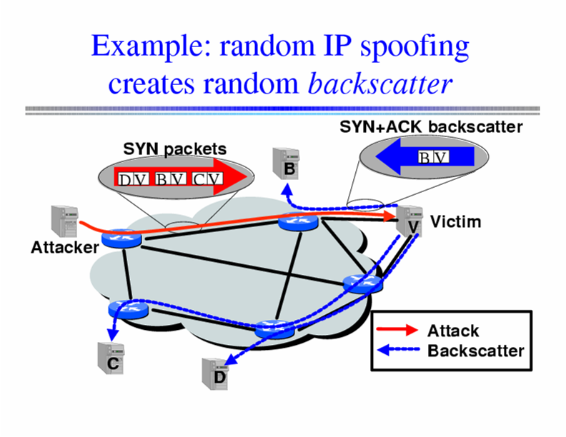
Inferring DoS Activity: Backscatter
IP address spoofing creates random backscatter.
pretty diagram courtesy of Feamster

Slide 25
Backscatter Analysis
Use a big block of addresses (N of them)
  People often use a /16 or /8
Observe x backscatter packets/sec
How big is actual attack?
  x * (2^32 / N)
  Assuming uniform distribution
Sometimes called “network telescope”
  2001: 12,805 attacks in 3 weeks (not all types!)
  Some > 600,000 packets per second.
  Today's botnets probably MUCH larger (next time. :)

